Slide 1
Cost-Effectiveness Analysis of Out-of-Hospital Cardiac Arrest (OHCA) Management Strategies

Slide 2
Introduction
Out-of-hospital cardiac arrest (OHCA) is the sudden cessation of the heart in an out of hospital setting. In the United States, the incidence of OHCA is estimated at 110 individuals per 100,000 . The overall survival rate is 10.8%. The American Heart Association (AHA) guidelines recommends angiography for patients who have ST elevation in electrocardiogram followed by proper treatments. In patients without ST elevation, other general test and observations would be conducted before further interventions. Some evidence suggests that angiography and immediate percutaneous intervention for OHCA patients could result in better healthcare outcomes regardless of the presence of ST elevation in electrocardiogram. The goal of this study is to investigate whether immediate angiography and PCI are cost-effective compared to the standard of care. It is important to state the time duration.

Slide 3
Methods
We built a decision tree model in TreeAge Pro to compare the cost-effectiveness of immediate angiography followed by proper interventions to standard care. The model calculates the costs and benefits of each strategy over a one-year time-horizon. We reviewed the literatures to obtain the model parameters, including the outcome probabilities, intervention costs, quality of life weights and life expectancy estimates. We calculated the incremental cost-effectiveness ratio of immediate angiography strategy compared to standard of care. In addition, we calculated the robustness of our outcomes using one-way sensitivity analysis, and probabilistic sensitivity analysis (PSA) were varied all the parameters jointly.

Slide 4
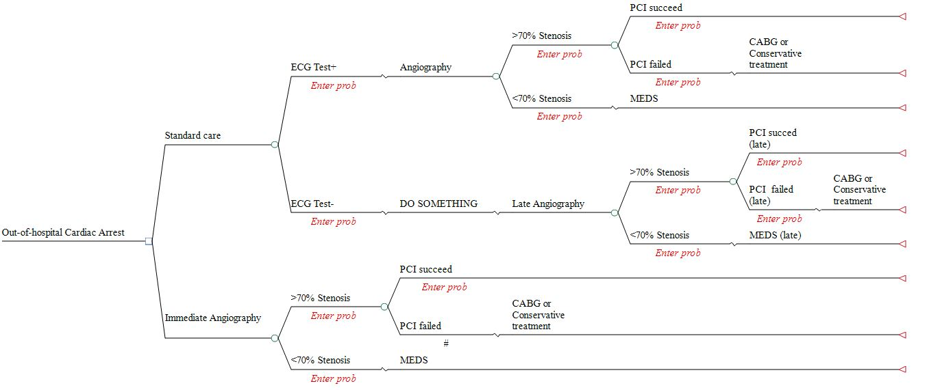
Model

Slide 5
Base case estimates and ranges
 | Base Case Estimate | Range | Reference or Source | Notes
Probability values All are following Beta distribution
Sensitivity of EKG | 0.88 | 0.74-0.96 | (3) | α= 36.3; β=4.95
Larger than 70% stenosis | 0.66 | 0.561-0.759* | (15) | α =58.58; β =30.18
Larger than 70% stenosis conditional on true positive EKG result | 0.96 | 0.816-1.000* | (2) | α =6.15; β =0.256
Larger than 70% stenosis conditional on false negative EKG result | 0.58 | 0.493-0.667* | (2) | α =74.09; β =53.65
PCI succeed | 0.74 | 0.629-0.851* | (2) | α =45.48; β =15.98
Cost ($) All are following Log normal distribution
Procedures of PCI | 35,991 | 18,842-53,140 | (8) | µ=10.46; σ=0.235
Procedures of CABG | 39,581 | 25,828-53,334 | (8) | µ =10.57; σ =0.173
Procedures of medical treatment in immediate action | 37,478** | 31,856-43,100* | (9) | µ =10.53; σ =0.075
Procedures of medical treatment in delayed action | 38,154** | 32,431-43,877* | (10) | µ =10.55; σ =0.075
Quality adjusted life-years (QALY) All are following Beta distribution
PCI procedures in immediate action | 0.82 | 0.63-1.00 | (3) | α=12.59; β =2.76
CABG procedures in immediate action | 0.80 | 0.64-0.96 | (3) | α =19.2; β =4.8
Medical treatments | 0.911 | 0.77-1.00* | (7) | α =13.95; β =1.36
PCI procedures in delayed action | 0.700 | 0.595-0.805* | (6) | α =52.63; β =22.56
CABG procedures in delayed action | 0.643 | 0.547-0.740* | (6) | α =63.42; β =35.21
The base case value means the best estimate for each variables. Unless otherwise noted, ranges are defined by 95% confidence intervals. * The range are estimated from 85% to 115% ** The values are from the calculation of inflation ¶ estimate from the study

Slide 6
Analysis
For both treatment strategies, our model calculated quality adjusted life years and costs in 1-year time horizon. We compared the performance of the two treatment strategies through the incremental cost-effectiveness ratio (ICER), defined as marginal cost divided by the marginal effectiveness. We conducted one-way sensitivity analyses for every variable in our model to assess the influences of them within a clinically plausible range on cost-effectiveness. And we plotted the Tornado diagrams for probability, cost and effectiveness. Additionally, we conducted Probabilistic sensitivity analysis (PSA) through Monte Carlo simulation. We thought probabilities and quality adjusted life-years are following Beta distribution and the cost of interventions are following Log-normal distribution.

Slide 7
Results
Immediate angiography was more expensive than the standard care ($122) per patient treated, but more effective [0.03 quality-adjusted life-years (QALYs)], resulting in an ICER of $3600/QALY compared to the standard care. These findings were robust to all one-way sensitivity analyses. In addition, the PSA showed that there is more than 80% probability that immediate angiography is more cost effective than the standard care conditional on $100,000/QALY willingness to pay threshold.
Incremental Cost Effectiveness Ratio (ICER)
Strategy | Cost | Incr Cost | Eff | Incr eff | IncrC/E (ICER) | NMB | C/E
Standard care | 36951.73 |  | 0.81 |  |  | 3748.93 | 45394.51
Immediate Angiography | 37073.55 | 121.83 | 0.85 | 0.03 | 3637.16 | 5301.85 | 43744.19

Slide 8
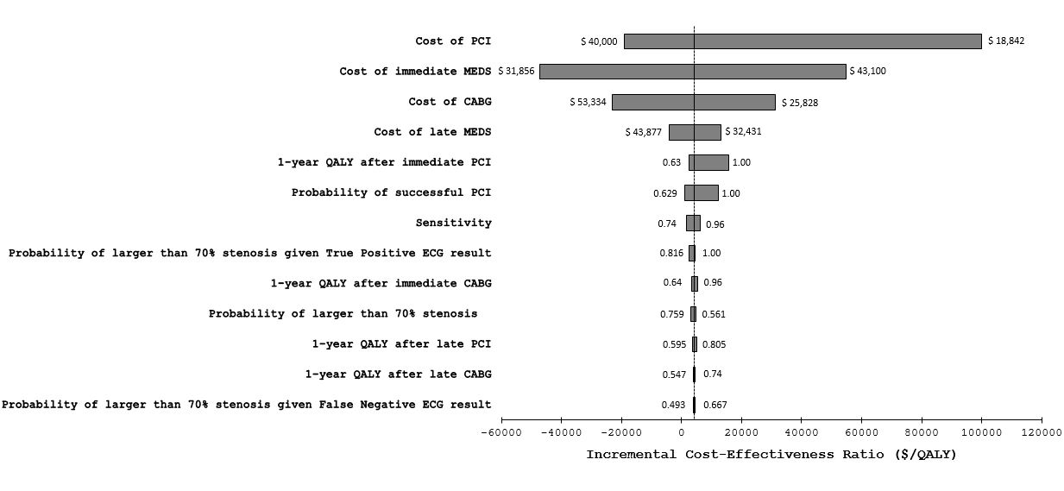
One-way sensitivity analysis (Tornado Diagram)

Slide 9
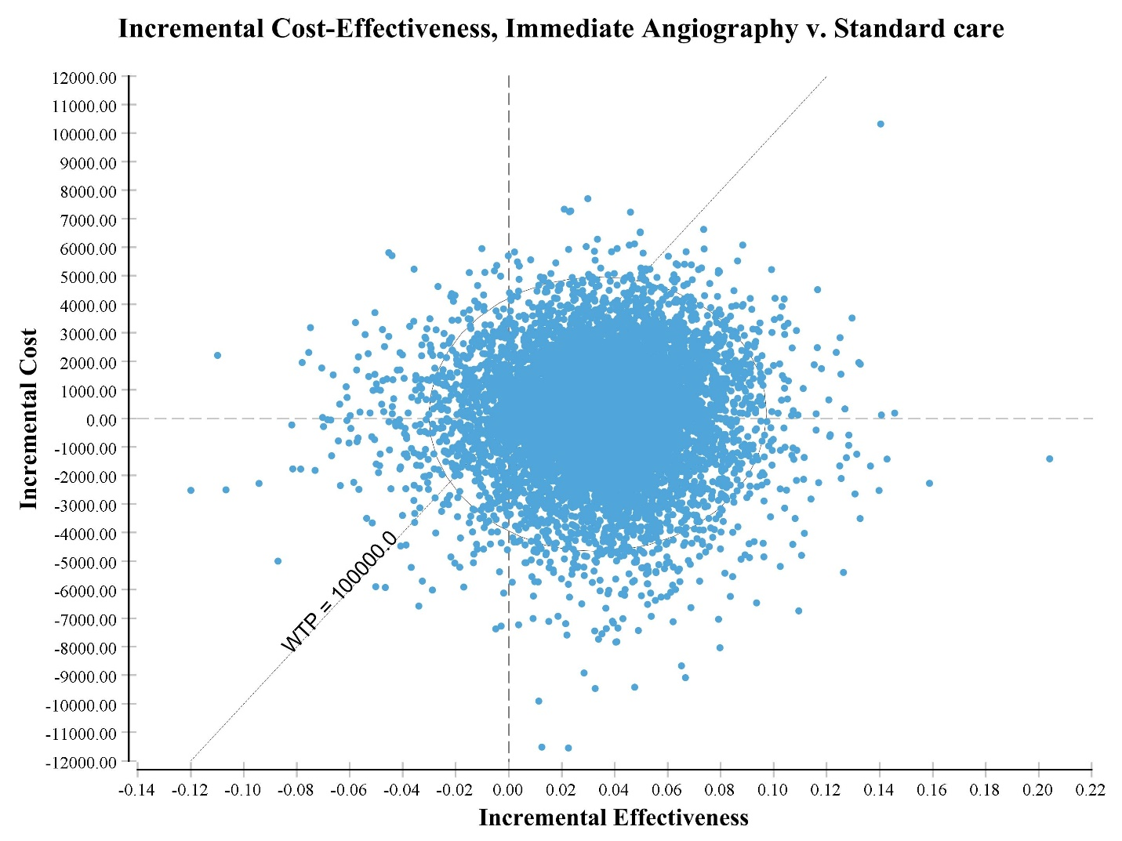
Probabilistic Sensitivity Analysis
C4
C6
C2
C3
C1
C5
Component | Quadrant | Incr Eff | Incr Cost | Incr CE | Frequency | Proportion
C1 | IV | IE>0 | IC<0 | Superior | 4097 | 0.4097
C2 | I | IE>0 | IC>0 | ICER<100,000 | 4366 | 0.4366
C3 | III | IE<0 | IC<0 | ICER>100,000 | 188 | 0.0188
C4 | I | IE>0 | IC>0 | ICER>100,000 | 706 | 0.0706
C5 | III | IE<0 | IC<0 | ICER<100,000 | 205 | 0.0205
C6 | II | IE<0 | IC>0 | inferior | 438 | 0.0438

Slide 10
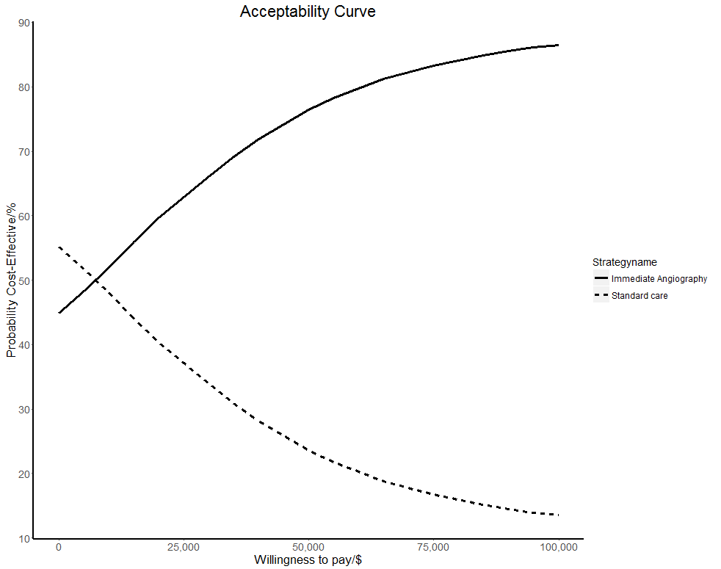
The acceptability curve shows the probability of being cost-effective under different threshold of willingness to pay.

Slide 11
Conclusion
Our results suggest that immediate angiography is more cost effective than the standard care for OHCA patients from a societal perspective because the ICER is well below the upper limit of the threshold that is generally considered to be cost-effective by many health-care agencies.

Slide 12
Future
Micro-Cost Analysis
Update latest data
Modifying treatment guidelines
Reallocating healthcare resources

